Slide 1

Smart Gym Tracker
Increment 3 Delivery

Slide 2


What is Smart Gym Tracker
Web based gym metrics tracking application
User-friendly interface
Simple look, but powerful features
Personalized and tailored experience for each user's desires
Users can track:
Workouts
Biometrics
Trends
Goal progress

Slide 3


Delivery Goals for Increment 3
Complete backend setup
Create user data trends
Create notification system
User created goals
User specific milestones, suggestions, and progress tracking
?

Slide 4
Updates and changes On Project Goals
Positive Updates:
Frontend and Database met all features and expectations for final release.
Documentation reviewed and finalized
Frontend designs and pages all created
Database schema and communication fully setup
Backend has some working functionality
Bugs:
No bugs at current time
All released systems will build and run independently
Database and frontend functioned properly on testing
Blockers:
Limited cross-system communication
Backend seen more blockers and was not completed
Testing of some functionality blocked

Slide 5
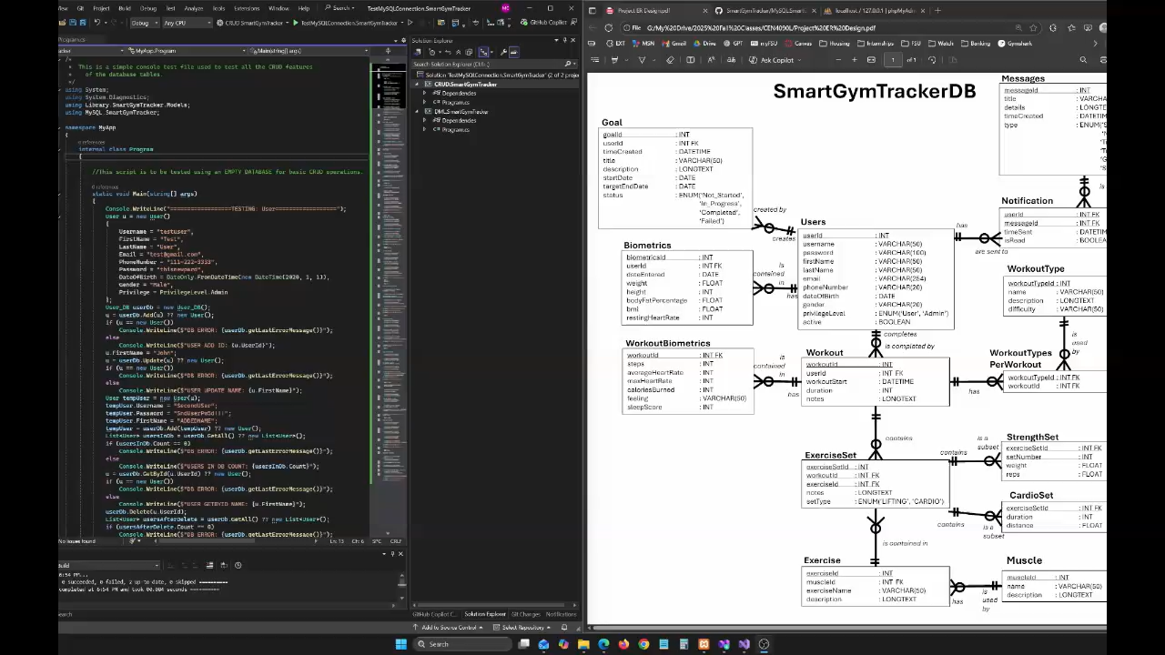
Demo - Database

Slide 6


Thank You
Questions?

